Slide 1
CYPRUS
Explore Cyprus – Fact Sheet

Slide 2
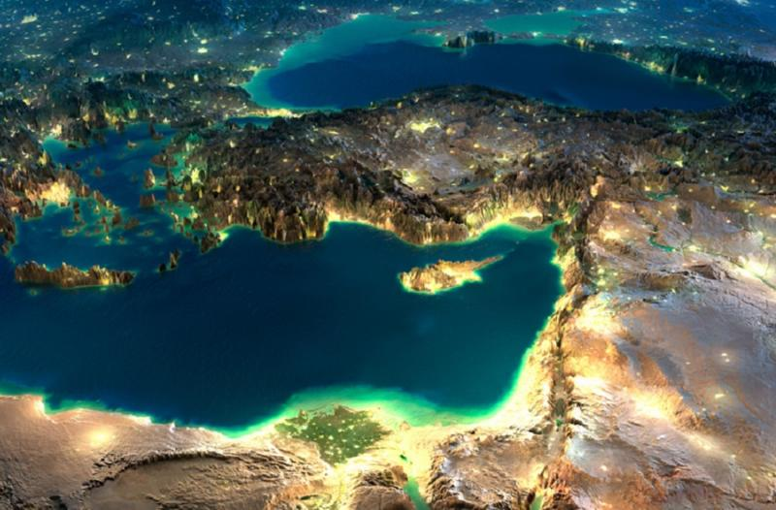
Cyprus
It was part of the British Empire from 1914 under military occupation from 1914–1925 and a Crown colony from 1925–1960.
Cyprus Time is Greenwich Mean Time (GMT) +2 hours. Time difference from Hong Kong is +8
Is an island country within the Mediterranean Sea and the third largest and third most populous island in the Mediterranean. Is an ideal investment gateway to the European Union, as well as a portal for investment outside the EU, particularly into Middle East, India and China.
It has a highly developed system of primary and secondary education offering both public and private education. The high quality of instruction can be attributed in part to the fact that nearly 7% of the GDP is spent on education which makes Cyprus one of the top three spenders of education in the EU
Is an independent sovereign Republic with a presidential system of government. Executive power is exercised by the President who is elected universal suffrage for a five-year term.
It has an easy access to major markets:
Greece-Athens approx. 2h
UK-London approx. 5h
United Arab Emirates- Dubai approx. 3h

Slide 4
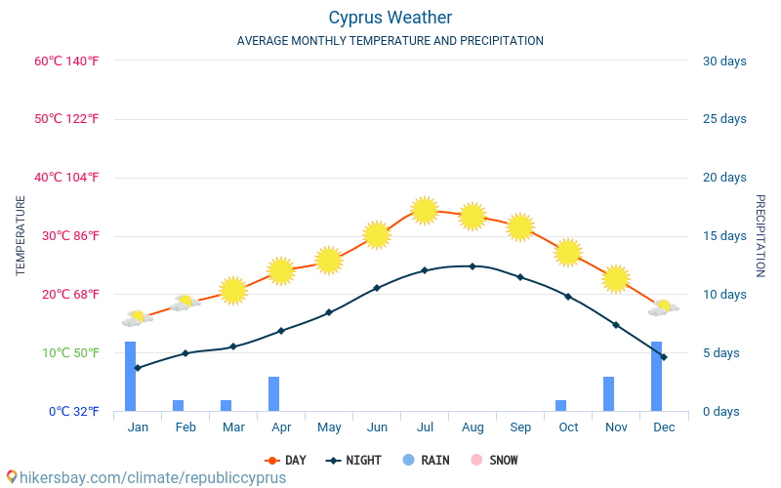
CLIMATE & WEATHER
Weather Forecast
You can access weather forecast for the island through various sources:
Radio
Television
Newspapers: The weather forecast is published daily in the ‘Cyprus Mail’, the island’s only daily English newspaper.
Meteorological Service Website: www.moa.gov.cy
Climate
Cyprus enjoys an intense Mediterranean climate, with long dry summers from mid-May to mid-October, mild winters from December to February, short autumn and spring seasons.
Abundant sunshine
Even in December and January, there is an average of six hours of bright sunshine per day, whilst over the six ‘summer’ months, there is an average of 11.5 hours of bright sunshine per day.
Summer:
High temperatures with cloudless skies
Sea breeze creates a pleasant atmosphere in the coastal areas
Winter:
Mild with rain and snow on Troodos Mountains (usually starting before Christmas)

Slide 5
COMMUNICATIONS
Directory Inquiries
A 24-hour service for directory inquiries in Cyprus is available by dialling: 11892 or 11822 or 11800 or 11833 or 11811.
Information for foreign customers, country codes and area codes can be obtained by dialling: 11894.
Post Offices
You can send mail from post offices located throughout the island and at the airports, or using the yellow mailboxes on the street. Stamps may be purchased from all post offices, postal agencies, as well as from many hotels, newsstands, kiosks, etc.
Courier Services
Courier Services are available by the relevant section of the Postal Services, and by private companies, in all towns.
Whilst airmail letters take approximately three to four days to Europe, courier services offer a speedier ‘next day or sooner’ delivery service
Telecommunications
Both national and international foxed voice services, Internet access and data services (both narrowband and broadband) are offered by a number of providers.
Making Calls:
Call to Cyprus from abroad: dial 00357 and then the eight-digit phone number
Calling within Cyprus: simply the eight-digit phone number
Calling abroad: dial 00 followed by the country code and the telephone number
International Dialling Code for Hong Kong: 00852

Slide 6
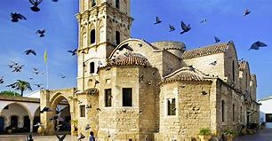
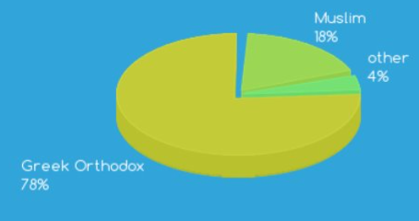
LANGUAGES & RELIGIONS
Languages
The official languages of the island are Greek and Turkish, whilst English is widely spoken. French, German and Russian are also spoken within the tourism industry.
Religion
Cyprus enjoys an exceedingly high level of freedom of worship. While the majority of Greek-Cypriots are Greek Orthodox Christians, other denominations are represented on the island, including Armenians, Maronites and Roman Catholics. The Turkish-Cypriot community is predominantly Muslim

Slide 7
MONEY & CURRENCY
Currency
On January 01, 2008, the Republic of Cyprus introduced the Euro (€) as its official currency, replacing the Cyprus pound (CY£) as the legal tender of Cyprus, at the irrevocable fixed exchange rate of €1 = CY£ 0,585274.
There are seven denominations in Euro banknotes: 5, 10, 20, 50, 100, 200 and 500. They are all distinguished by a different colour and size, with the higher the denomination, the bigger the size.
One Euro is divided into 100 cent. There are eight Euro coins: 1, 2, 5, 10, 20 and 50 cent, and 1 and 2 Euro.
Currency Exchange
All banks operating in Cyprus offer foreign currency exchange services and quote the exchange rates of the Euro against all major foreign currencies daily.
There Foreign currency can also be exchanged at hotels. More detailed information concerning exchange rates can be obtained from the Central Bank of Cyprus.
Import/Export – Banknotes, Currency and/or Gold
There are no restrictions on the import and export of cash or gold for travellers from and to another EU Member State.
However, travellers arriving from, and departing to, another EU Member State or a third country and carrying a sum of Euros 10,000 or more - in any currency, in cash (banknotes and bearer negotiable instruments) or gold - must be declared at Customs.

Slide 8
HEALTH & SAFETY
Safety in Cyprus
Cyprus has an excellent reputation for being a safe and friendly place.
Crime in Cyprus is, comparatively, at a very low level.
The Police Force is always ready to provide any assistance to persons who need help.
Chemists/Pharmacies
All Medicine can be purchased at pharmacies on presentation of a doctor's prescription. Almost all brands of medicine are available in Cyprus. Pharmacies are all marked with a green cross.
Food Safety and Drinking Water Quality
There are no restrictions on the import and export of cash or gold for travellers from and to another EU Member State.
However, travellers arriving from, and departing to, another EU Member State or a third country and carrying a sum of Euros 10,000 or more - in any currency, in cash (banknotes and bearer negotiable instruments) or gold - must be declared at Customs.
Medical Services
Medical care needs in Cyprus are met through Government General Hospitals and Private Clinics / Hospitals.
The majority of doctors can converse in English, whilst nursing staff speak a range of languages.
Foreign Diplomatic Missions in Cyprus
Should you need to contact your country’s embassy on the island, detailed information concerning foreign Embassies and High Commissions in Cyprus can be obtained from the Ministry of Foreign Affairs.

Slide 9
Access to EU and high growth markets: As a member of the wider EU and Eurozone community, Cyprus ensures safety and stability for investors with access to more than 500 million EU citizens
4
40+ EU Trade Agreements
⁄ 65 double tax treaties
1
Geostrategic position
between 3 continents
2
Proximity and easy access to major markets
Full access to the European Single Market
EU (2004) and Eurozone member (2008)

Slide 10
An ideal base within the EU
Positive economic outlook
Attractive tax regime
Strong business support services
Access to talent
Access to markets
Low cost of doing business
High quality of life
Excellent regulatory structure

Slide 11
Positive economic outlook
Robust GDP growth (4% in 2018)
Consolidated, recapitalized and restructured banking sector with solid capital base
Positive macroeconomic forecasts of >3% growth until 2021
Public finances in surplus
position (2.8% in 2018)
Consecutive upgrades by
Credit rating agencies
Unemployment below EU av

Slide 12
Cyprus Economy Setup
Real Estate
Professional Services
Reputable law firms
Accounting Firms
A good stock of properties for purchase and rent is available:
Townhouses, Apartments, Villas, Seaside bungalows, office spaces etc
Shipping
Merchant shipping has developed rapidly ranking Cyprus as the main maritime powers of the world
the 11th largest fleet globally
the 3rd largest fleet in Europe
Information and Communications Technology (ICT)
Strong Network of Companies
Higher Education
International schools and universities with the UK System
Energy
Oil & Gas
Renewable energy
Tourism & Hospitality
Casino Resort “City of Dreams”
Golf resorts
Traditional Cuisine
Investment Funds
Cyprus has become a leading jurisdiction for funds after the modernization of the legislative and regulatory framework.

Slide 13
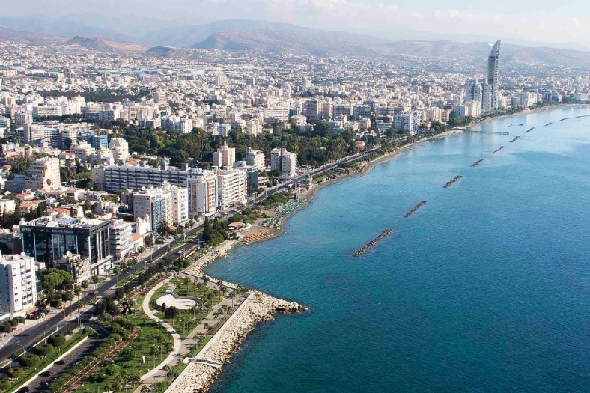
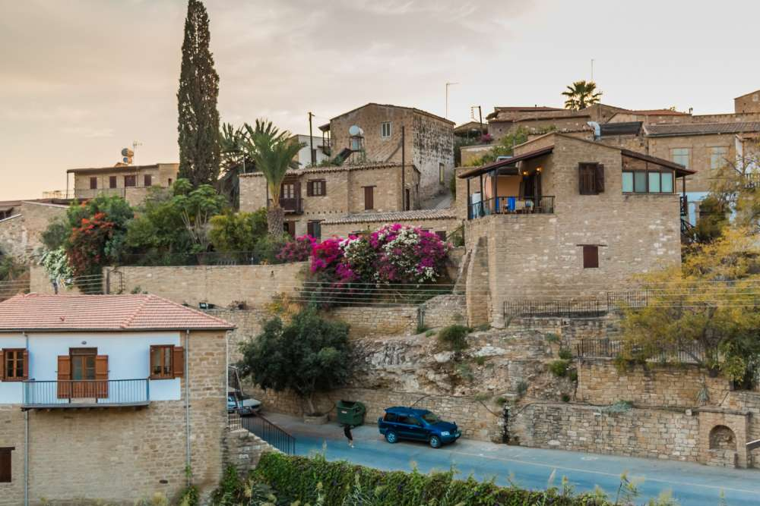
Real Estate Statistics
70% of transactions are by NON-EU residents
5% YoY growth on Residential Index
20% increase in the sale contracts for high-end residential properties of over €2m
8% increase in the sale contracts for high-end residential properties of over €2m
72% annual growth in sales contracts in the Cyprus East Coast transactions are by NON-EU residents
14% tourism growth from 2017 to 2018

Slide 14
Property Market

Slide 15
Shipping success stories in Cyprus

Slide 16
Attractive tax system
Income tax New Residents
Income > €100K/year
o50% for the first 10 years
Income < €100K/year
o20% for the first 5 years
Corporate Tax
12.5% corporate tax rate
EU & OECD Compliant / Access to EU directives
No tax on profits from disposal of securities
No withholding taxes
No tax on capital gains under conditions
Notional Interest Deduction (NID) on investment in Cypriot companies
IP BOX offers up to 80% deduction in corporate tax
Investor’s benefits
“Non-dom” provisions:
oExempt from SDC tax rate on
dividends, interest and rental income
oExempt from income tax on dividends and interest
oRental income only subject to
income tax

Slide 17
Low cost of doing business
Labour costs
Office rental
Business services
Cost of living

Slide 18
Education

Slide 19
ICT success stories in Cyprus

Slide 20
Oil & Gas:An Emerging Energy Player
O&G majors
World-class discoveries
Exploration & Development
Monetization (LNG)
Multi-billion projects
Regional service base
EastMed gas pipeline
EuroAsia Interconnector

Slide 21
Living in Cyprus RANKINGS
Rich history and culture
Natural beauty
RANKINGS
Top 5 safest country in the world (Value Penguin)
Safest country for young people (Guardian)
Top 4 best retirement destinations globally (Knight Frank)
Best island economy lifestyle & human capital (fDi magazine)
Most blue flag beaches per capita in the EU (Eurostat)

Slide 22
Living in Cyprus QUALITY OF LIFE
1. Cyprus offers visitors a wonderful living experience that combines
a comfortable and stress-free way of life with
a modern and sophisticated environment
2. Cyprus is ideal for people seeking the perfect balance between
Business and
Pleasure
3. Cyprus has the most ”BLUE FLAG”-awarded beaches in Europe. In 2018, a total of 64 beaches have been awarded the Blue Flag.
4. Cyprus boasts very high quality agricultural products, of which many are exported to Middle East and Asian Countries.
5. Agricultural land featuring red soil is considered to be the best in the country for providing top quality fresh fruits & vegetable year-round
6. Cyprus has one of the lowest pollution rates in the world

Slide 23
Living in Cyprus Tourism and Hospitality
New & Upcoming Projects
More than 20km of coastal footpaths
18 holes Golf Course Resort
Ayia Napa & Protaras Marinas
(Ayia Napa Marina, set to be the biggest in Europe)
New Private University
New Casino
Ayia Napa Casino is the new casino growing to become a leading gaming destination in Europe.
World-class gaming
Exceptional dining
Amazing rewards
Outstanding service
Luxury – Style - Comfort

Slide 24
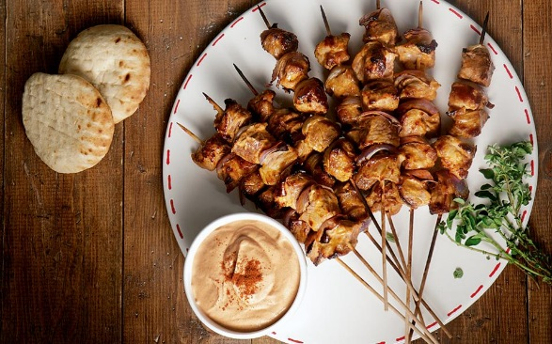
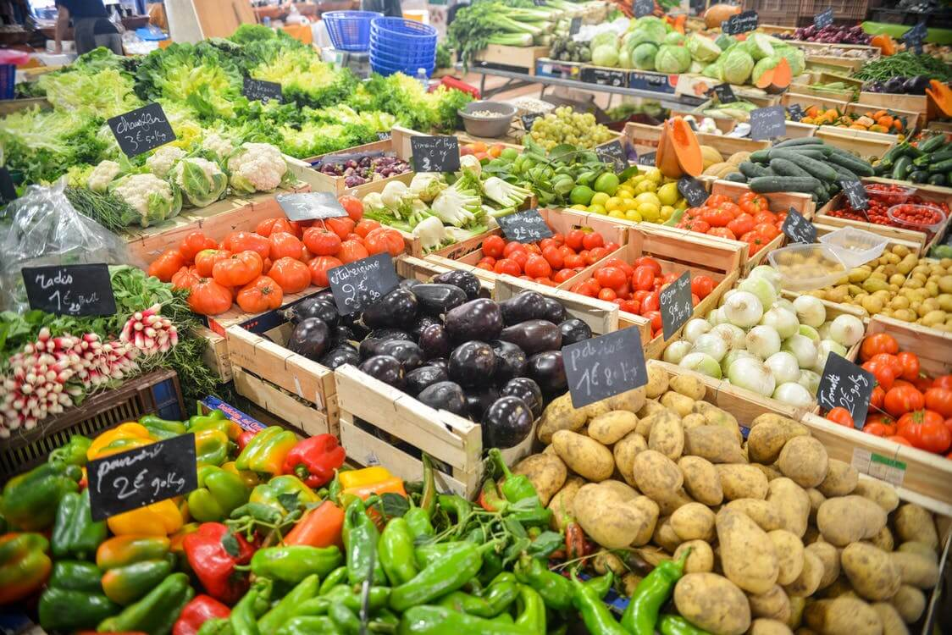
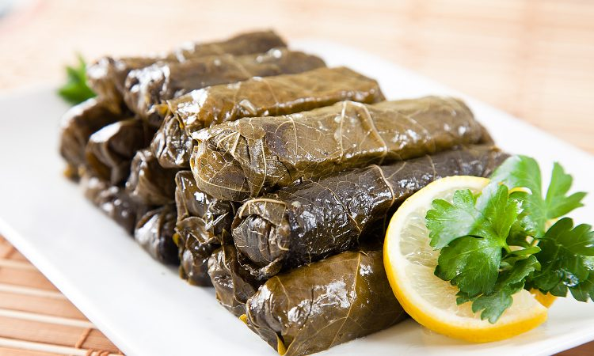
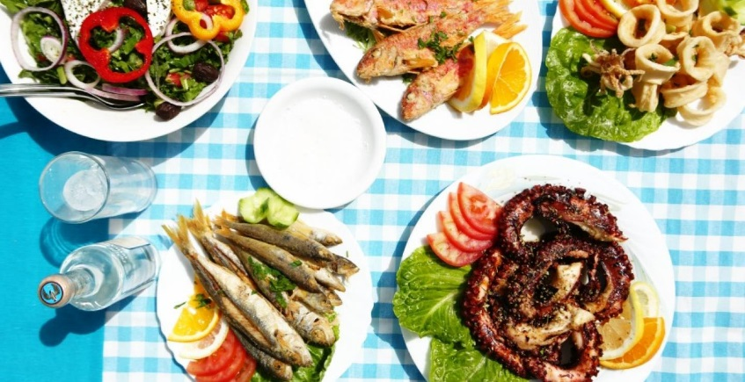
Living in Cyprus CYPRIOT CUISINE
Cypriot food bears a distinct resemblance to Greek Mediterranean cooking which is one of the healthiest cuisines, but also has Turkish and Lebanese influences.
Types of Cypriot food:
Fresh fish (squid, trout, octopus, red mullet ,sea bass)
Meat (lountza (smoked pork loin), charcoal-grilled lamb, souvlaki (pork and chicken cooked over charcoal) sheftalia)
Fresh vegetables and fruits. (courgettes, green peppers, okra, green beans, artichokes, carrots, tomatoes, cucumbers, grape leaves (koupepia) lettuce, potatoes)

Slide 25
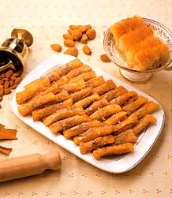
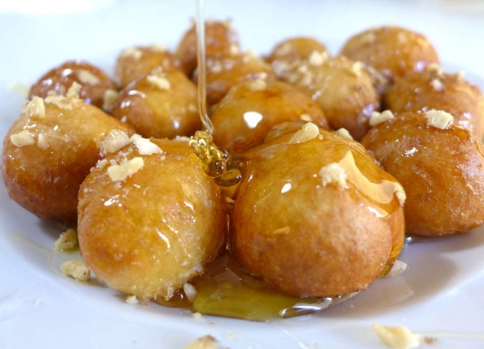
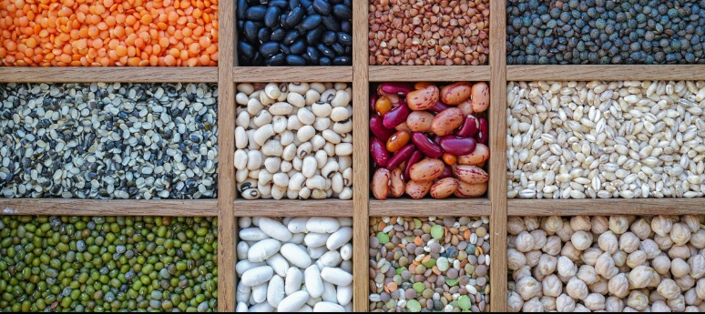
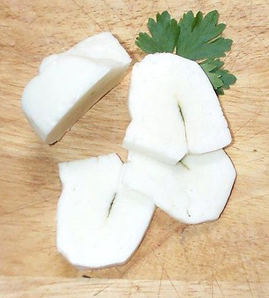
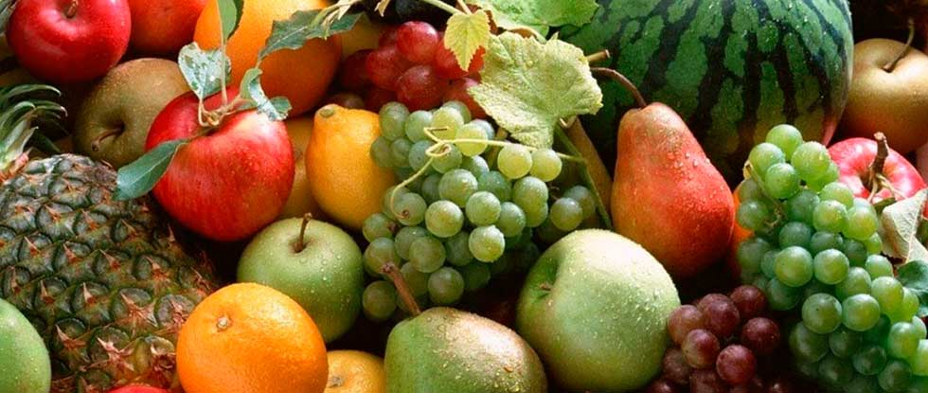
Living in Cyprus CYPRIOT CUISINE
As in other Mediterranean countries, eating is an activity to be savored and enjoyed and is certainly not to be rushed in any way.
Pulses (beans, peas, black-eyed beans, chick-peas and lentils)
Fruits and nuts (pears, apples, grapes, oranges, mandarines, nectarines, medlar blackberries, cherry, strawberries, figs, watermelon, melon, avocado, lemon, pistachio, almond, chestnut, walnut, hazelnut)
Desserts (lokumades, daktyla, Soutzoukos)
Halloumi cheese

Slide 26
Thank you

